Slide 1
Northwind data analysis

Slide 2
The Northwind database is a sample database used by Microsoft to demonstrate the features of some of its products, including SQL Server and Microsoft Access. The database contains the sales data for Northwind Traders, a fictitious specialty foods exportimport company.

Slide 3
Data analytics is the process of examining data sets to uncover hidden patterns, trends, and insights, ultimately leading to better decision-making.

Slide 4
Tools used
SQL management server

Slide 5
Steps followed
Imported Northwind dataset into SQL Server
Used SQL functions to query dataset and answer the questions
Copied the output

Slide 6
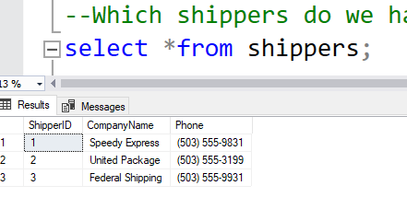
1.Which shippers do we have

Slide 7
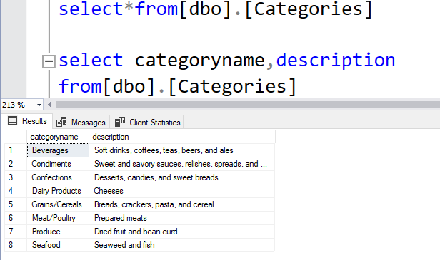
2.Certain fields from categories

Slide 8
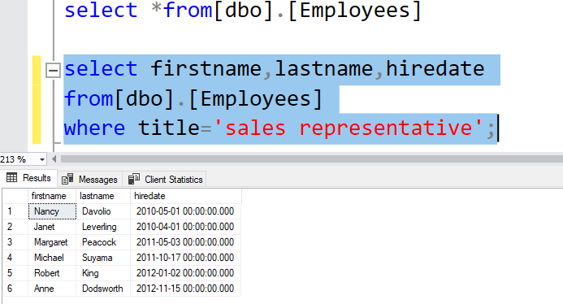
3.Sales representatives

Slide 9
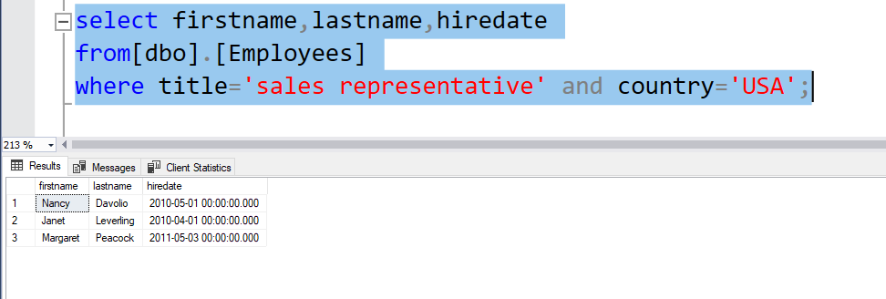
4.Sales representative in the united states

Slide 10
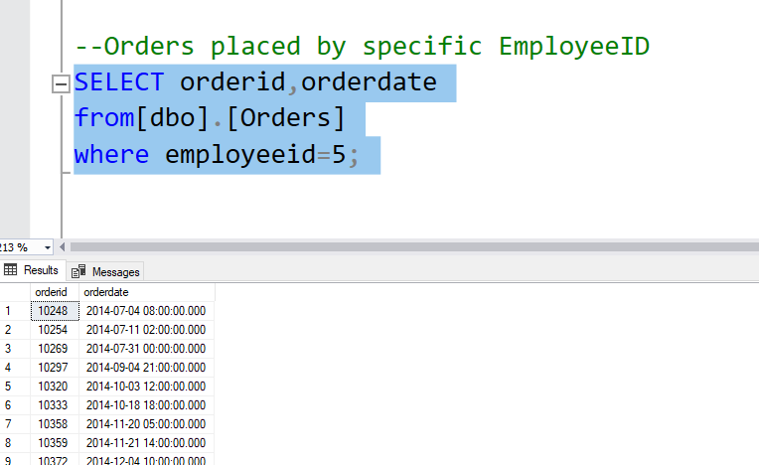
5.Order placed by specific EmployeeId

Slide 11
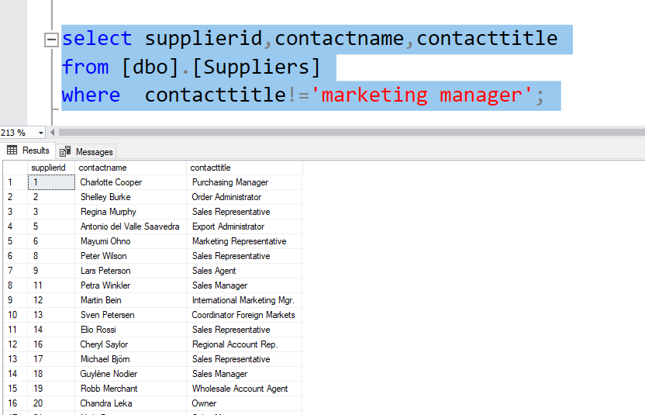
6.Suppliers and contact titles

Slide 12
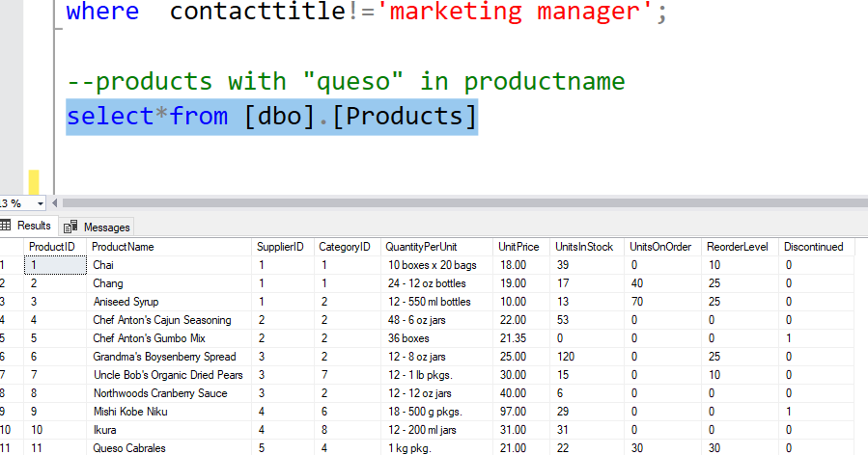
7.products with "queso" in productname

Slide 13
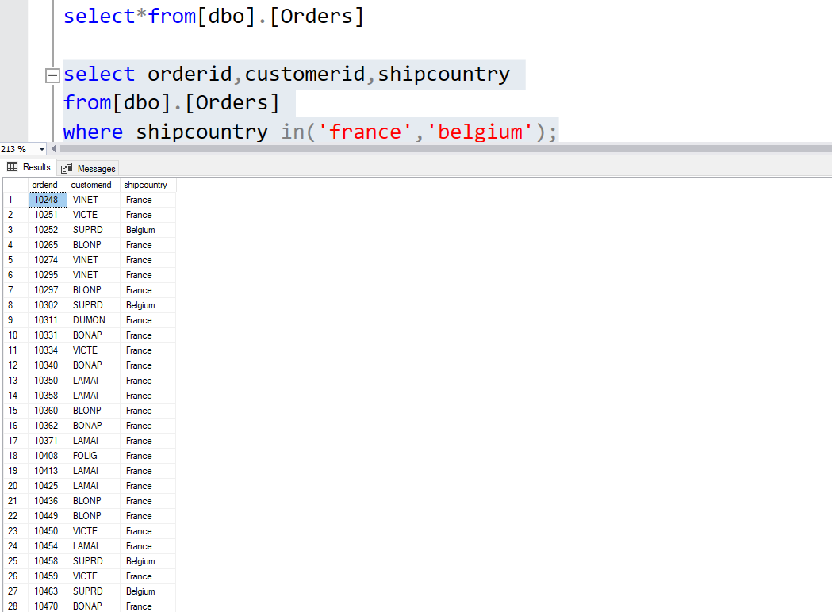
8.orders shipping in france or belgium

Slide 14
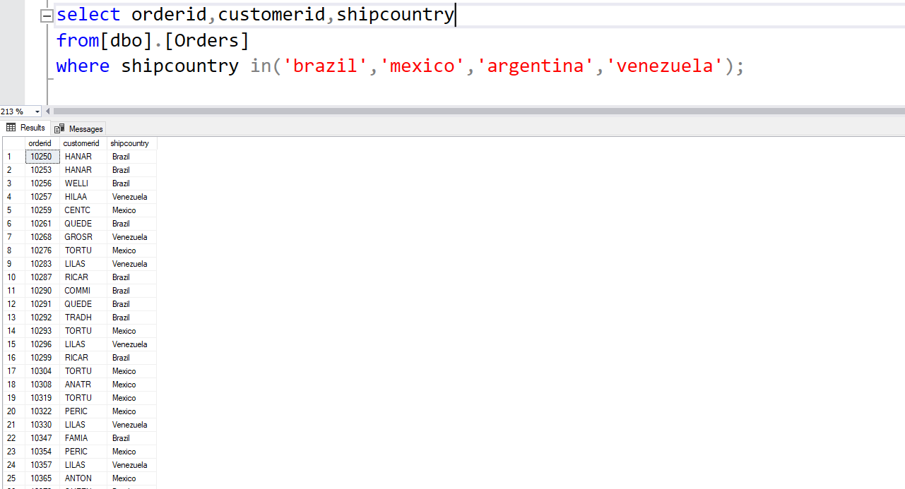
9.orders shipping to any country in latin america

Slide 15
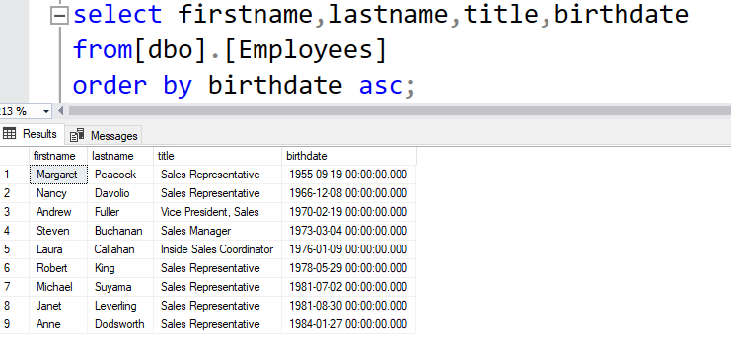
10.Employees in order of age

Slide 16
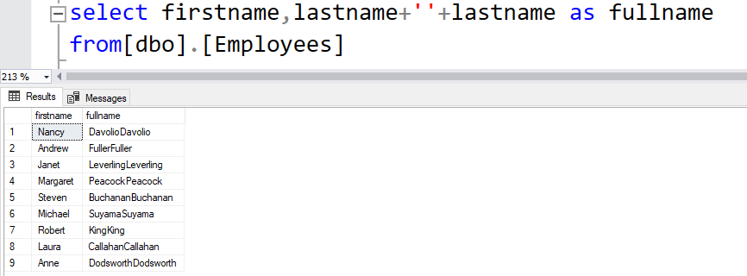
11.employees full name

Slide 17

Created by- AS Keerthana

